Slide 1

Body Fat Prediction STAT 628, Module 2
Group 3: zheng ni, jingpeng weizhou, zifeng wang, Ke chen
Date: oct 10, 2019

Slide 2
Outline
Introduction
Data Preprocessing
Model selection
Model diagnostics
Conclusion

Slide 3




Introduction
Background (Body Fat Percentage)
A crucial index for describing health condition
Previous calculation methods are costly
Goal
To provide a simple and accurate rule-of-thumb method
To provide a model only require available clinical data (costless measurement)

Slide 4
Introduction
Data Overview
252 men’s clinical measurement data
Available features
AGE | WEIGHT | HEIGHT | ADIPOSITY | NECK | CHEST | ABDOMEN | HIP | THIHG | KNEE | ANKLE | BICEPS | FOREARM | WRIST
years | lbs | inches | bmi | cm | cm | cm | cm | cm | cm | cm | cm | cm | cm

Slide 5
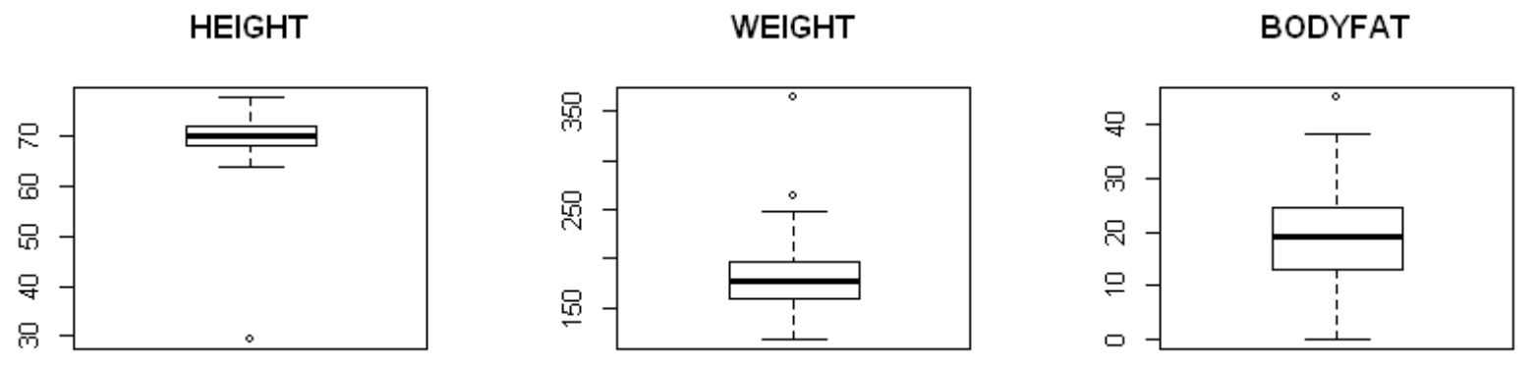
Data Preprocessing
Outliers Detection
Boxplot
Graph1: Examples of Boxplots

Slide 6
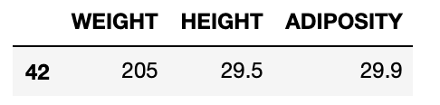
Data Preprocessing
For Measurement Error
Impute by BMI function (BMI = WEIGHT/(HEIGHT^2) * 703)
e.g. The height of No.42 is too short while the other measurement data seem normal → Inverse BMI: Height = (Weight/703*BMI)^{0.5}
Impute by regression method
Build a regression model for wrist first (Wrist~Ankle+Knee+Age)
Impute the value for the outlier
For Extreme value (not due to measurement error)
Drop these records (39, 41, 216)

Slide 7
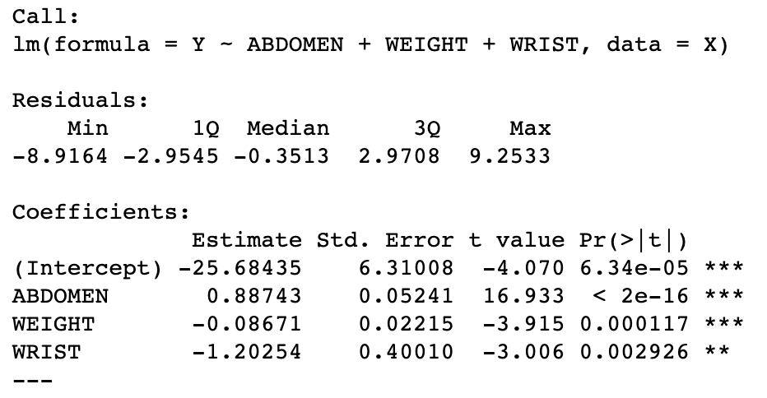
Model Selection
Forward regression
ABDOMEN, WEIGHT and WRIST are significant variables in forward regression
Backward regression
The performance of backward regression with criteria BIC is not so good here, so we won’t show the result here.

Slide 8
Model Selection
Model comparing.
In order to make model simple and easy to understand, we would only select two variable from the result of stepwise model. Comparing the two following models:
BodyFat = ABDOMEN + WEIGHT R^2 : 0.7103
BodyFat = ABDOMEN + WRIST R^2 : 0.7031
According to the R square and p=value of each variables, we select model with variable ABDOMEN and WEIGHT as final model.

Slide 9
Model Diagnosis
Model Assumptions:
Linearity of the data
Independence of residuals error terms
Homogeneity of variance
Normality of residuals

Slide 10
Model Diagnosis
Residuals vs Fitted
Scale Location

Slide 11
Normal Q-Q

Slide 12
Cook’s distance

Slide 13
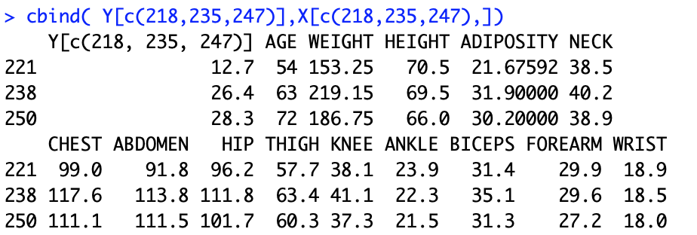
Influential points

Slide 14
Conclusion
Final model:
𝐵𝑂𝐷𝑌_𝐹𝐴𝑇=0.9005⋅𝐴𝐵𝐷𝑂𝑀𝐸𝑁−0.1187⋅𝑊𝐸𝐼𝐺𝐻𝑇−25.68435
Rule of Thumb:
In our model abdomen is positively correlated with body fat and weight is negative. These two can be the two general indices for the human body shape and weight. While two persons share the same body shape (abdomen), the one with higher body weight may have stronger body with lower body fat percentage.

Slide 15
Conclusion
Strength:
The accuracy of our model can be guaranteed while at the same time, the model is simple enough and easy to understand.
Weakness: Accuracy of our model is very high only based on the people with normal body size. However, the people whose body is extremely out of shape, cannot be estimated by this model accurately.
Conclusion

Slide 16
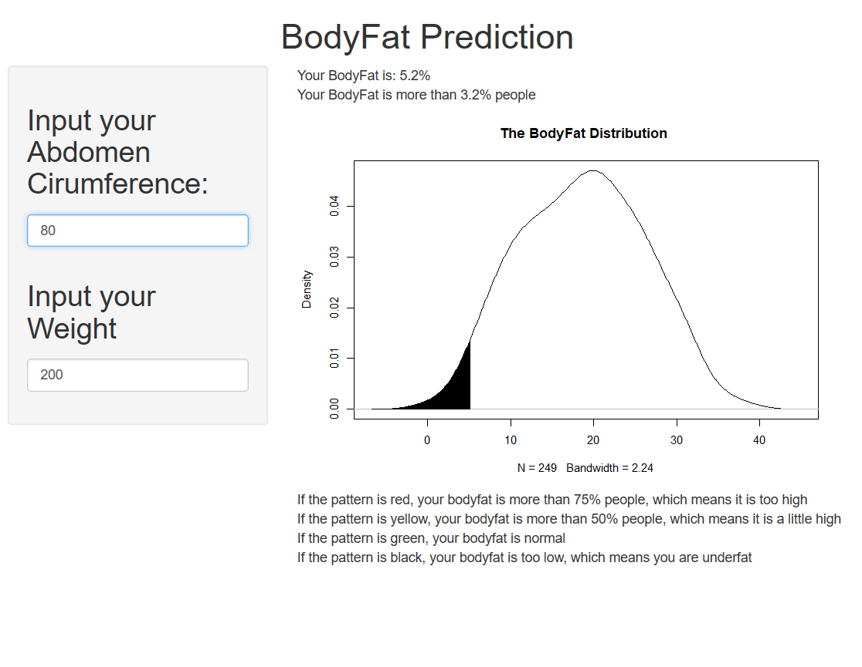
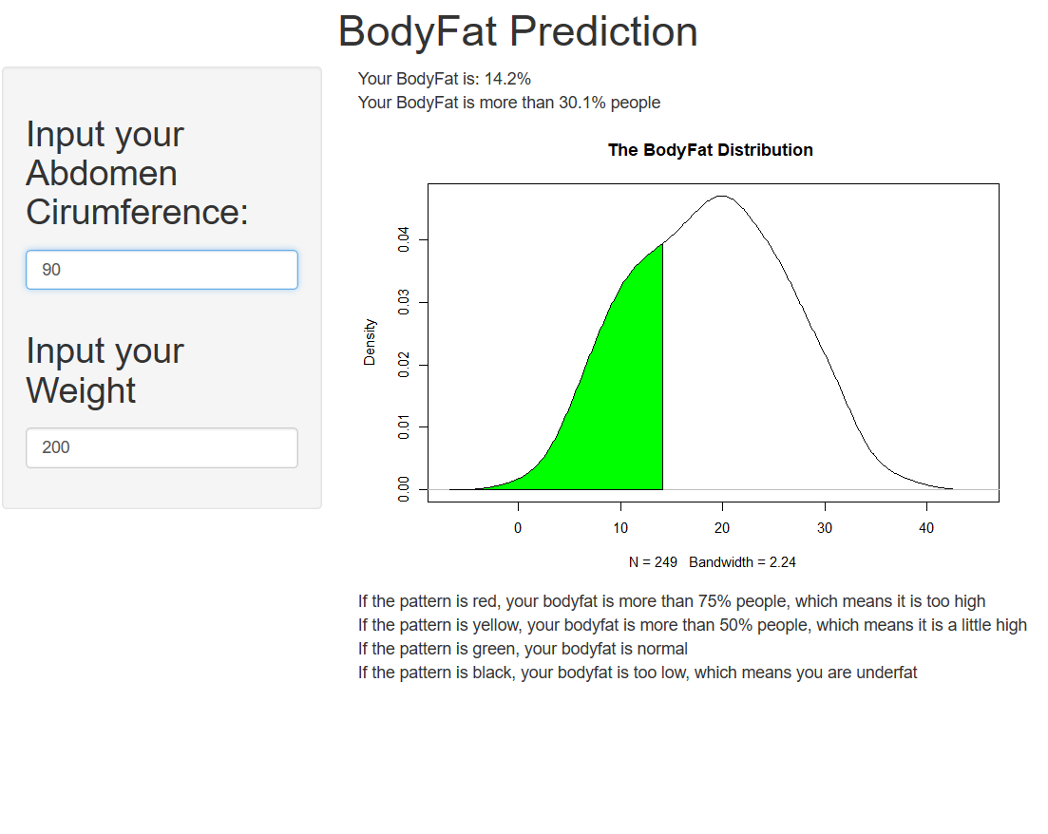
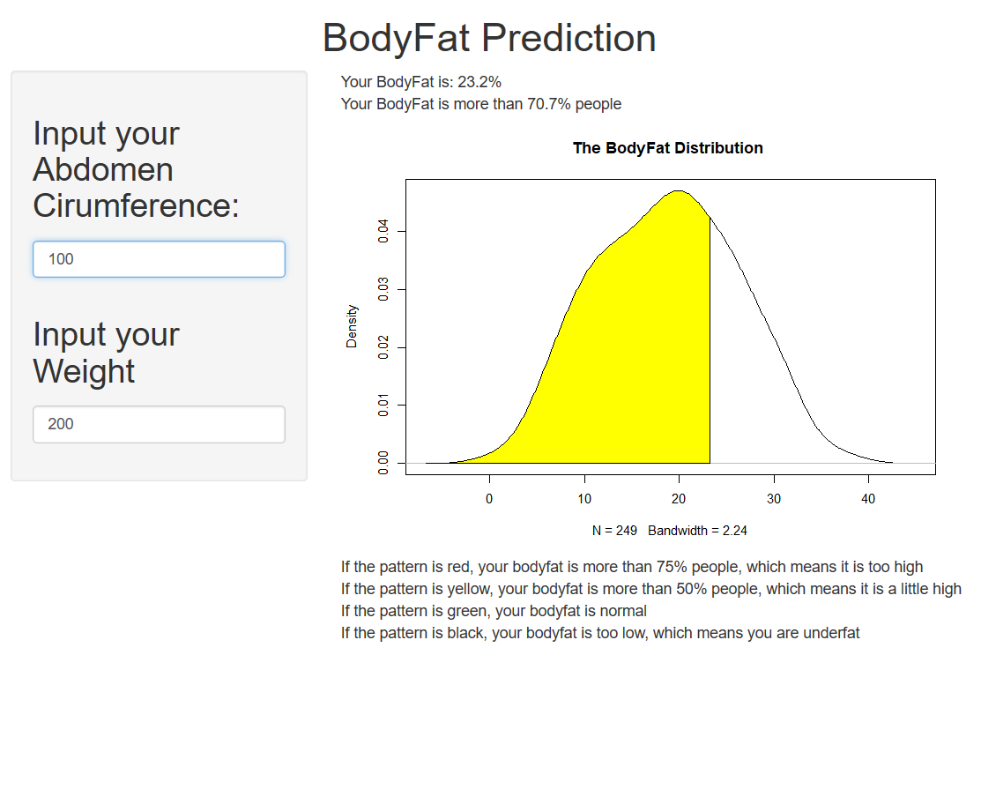
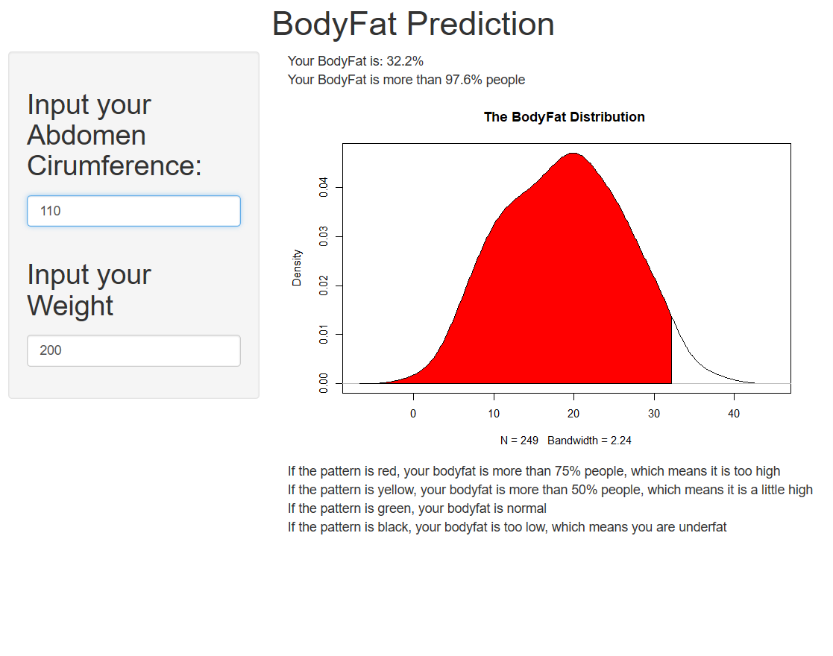
Conclusion
Shiny Graph

